Slide 1
Promoting the discrimination between psychological flexibility and inflexibility in children
Francisco J. Ruiz¹, Carmen Luciano², Daniela Salazar³, & Daniela Zuluaga-Hurtado⁴
¹Fundación Universitaria Konrad Lorenz, ²Universidad de Almería, Madrid Institute of Contextual Psychology, ³Light House Arabia, ⁴Universidad Católica de Pereira
Notes:
Thanks for coming. I am going to present the talk entitled “Interfacing research on Clinical RFT and ACT: The case of RNT-focused ACT.” This a honor for me to be here presenting the research line that made me to move from Spain to Colombia to get the opportunity to conform a laboratory dedicated to answer some intuitions regarding how to enhance ACT efficacy. I am going to try to be relatively brief, so I don’t have time to explain RFT concepts from the very beginning. However, I think almost all of you have the basic knowledge of RFT to follow this presentation.

Slide 2
Content
Conceptualizing psychological flexibility and inflexibility in RFT terms: How can it help us to apply ACT in children? Francisco J. Ruiz
Strategies to promote the discrimination between psychological flexibility and inflexibility in children. Daniela M. Salazar & Daniela Zuluaga-Hurtado
Conclusions and final remarks. Carmen Luciano
Questions
Notes:
Törneke, Luciano, Barnes-Holmes, and Bond (2016) identified two forms in which individuals respond to their ongoing behavior:
The first one was responding in coordination with its discriminative functions. This involves responding impulsively under the control of the derived functions of the own behavior. This form of responding is blind to values. The second way of responding is more flexible and it entails framing behavior in hierarchy with the deictic “I”, which allows other sources of stimulus control to enter in the stage.

Slide 3
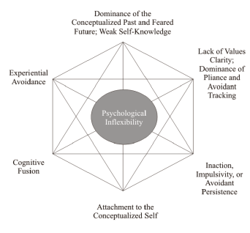
Psychological Inflexibility in middle level terms
Psychological inflexibility entails the dominance of private experiences in guiding behavior over chosen values (Bond et al., 2011).
Notes:
Törneke, Luciano, Barnes-Holmes, and Bond (2016) identified two forms in which individuals respond to their ongoing behavior:
The first one was responding in coordination with its discriminative functions. This involves responding impulsively under the control of the derived functions of the own behavior. This form of responding is blind to values. The second way of responding is more flexible and it entails framing behavior in hierarchy with the deictic “I”, which allows other sources of stimulus control to enter in the stage.

Slide 4
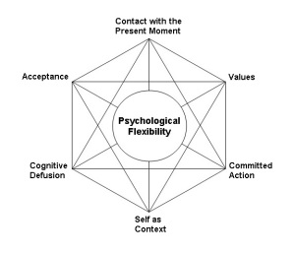
Psychological flexibility in middle level terms
Psychological flexibility is the ability to contact the present moment more fully as a conscious human being, and to change or persist in behavior when doing so serves valued ends (Hayes, Luoma, Bond, Masuda, & Lillis, 2006).
Notes:
Törneke, Luciano, Barnes-Holmes, and Bond (2016) identified two forms in which individuals respond to their ongoing behavior:
The first one was responding in coordination with its discriminative functions. This involves responding impulsively under the control of the derived functions of the own behavior. This form of responding is blind to values. The second way of responding is more flexible and it entails framing behavior in hierarchy with the deictic “I”, which allows other sources of stimulus control to enter in the stage.

Slide 5
ACT with children
Typical questions:
Can ACT be applied with children?
What age is appropriate?
What verbal repertoires need the child?
Aren’t ACT concepts too difficult to understand for children?
Notes:
Törneke, Luciano, Barnes-Holmes, and Bond (2016) identified two forms in which individuals respond to their ongoing behavior:
The first one was responding in coordination with its discriminative functions. This involves responding impulsively under the control of the derived functions of the own behavior. This form of responding is blind to values. The second way of responding is more flexible and it entails framing behavior in hierarchy with the deictic “I”, which allows other sources of stimulus control to enter in the stage.

Slide 6
RFT conceptualization of psychological flexibility: Two forms of responding to own behavior
Törneke, Luciano, Barnes-Holmes, and Bond (2016) identified two forms in which individuals respond to their ongoing behavior (including private events):
In coordination with its emotional and discriminative functions.
Framing behavior in hierarchy with the deictic “I.”
Notes:
Törneke, Luciano, Barnes-Holmes, and Bond (2016) identified two forms in which individuals respond to their ongoing behavior:
The first one was responding in coordination with its discriminative functions. This involves responding impulsively under the control of the derived functions of the own behavior. This form of responding is blind to values. The second way of responding is more flexible and it entails framing behavior in hierarchy with the deictic “I”, which allows other sources of stimulus control to enter in the stage.

Slide 7
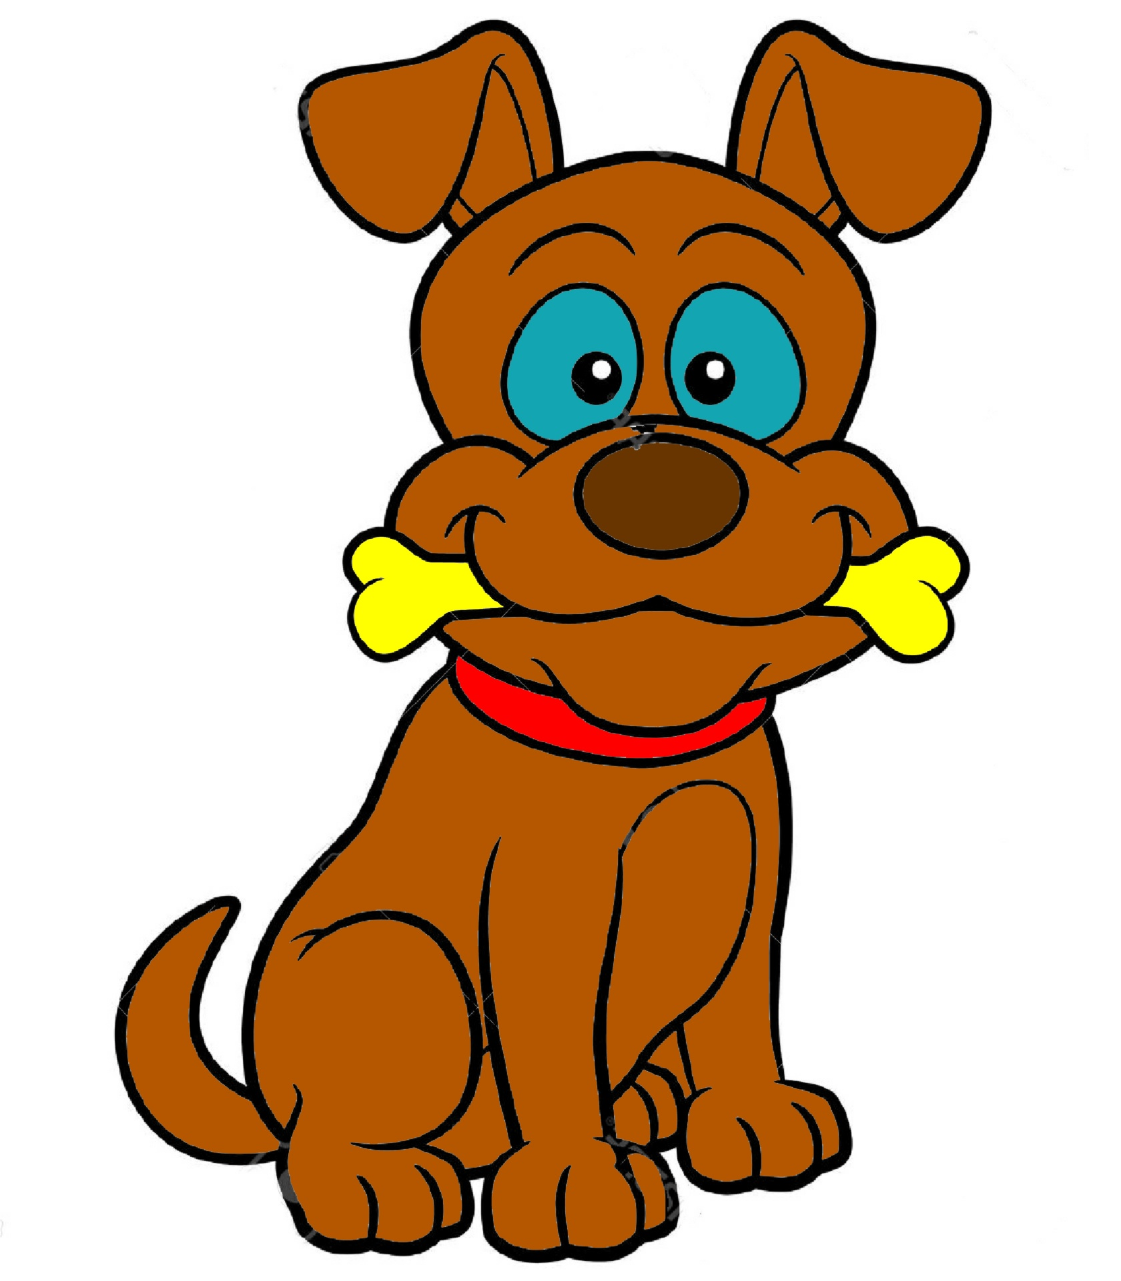
Where emotional and discriminative functions come from?
The emotional and discriminative functions can be directly conditioned or derived.
Dog
When children develops fluency in relational framing, more appetitive and aversive functions will show up.
Perro
Notes:
Törneke, Luciano, Barnes-Holmes, and Bond (2016) identified two forms in which individuals respond to their ongoing behavior:
The first one was responding in coordination with its discriminative functions. This involves responding impulsively under the control of the derived functions of the own behavior. This form of responding is blind to values. The second way of responding is more flexible and it entails framing behavior in hierarchy with the deictic “I”, which allows other sources of stimulus control to enter in the stage.

Slide 8
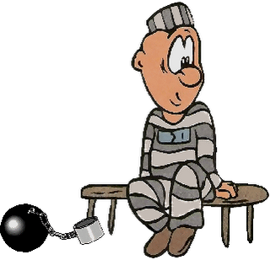
Responding in coordination with emotional and discriminative functions
It is the most simple way of responding.
It’s like being the prisoner of the functions actualized in the current context by the own learning history.
Individuals don’t have the “freedom” to choose their reactions. The functions of the ongoing behavior “choose” for them.
The reaction is blind to own values.
Notes:
Törneke, Luciano, Barnes-Holmes, and Bond (2016) identified two forms in which individuals respond to their ongoing behavior:
The first one was responding in coordination with its discriminative functions. This involves responding impulsively under the control of the derived functions of the own behavior. This form of responding is blind to values. The second way of responding is more flexible and it entails framing behavior in hierarchy with the deictic “I”, which allows other sources of stimulus control to enter in the stage.

Slide 9
Responding in coordination with emotional and discriminative functions
When functions are aversive, individuals will respond by engaging in some experiential avoidance strategy.
The specific experiential avoidance strategy will depend on the context and the learning history of the individuals.
In most learning histories, worry and rumination usually become the predominant experiential avoidance strategies.
Notes:
Törneke, Luciano, Barnes-Holmes, and Bond (2016) identified two forms in which individuals respond to their ongoing behavior:
The first one was responding in coordination with its discriminative functions. This involves responding impulsively under the control of the derived functions of the own behavior. This form of responding is blind to values. The second way of responding is more flexible and it entails framing behavior in hierarchy with the deictic “I”, which allows other sources of stimulus control to enter in the stage.

Slide 10
Framing behavior in hierarchy with the deictic “I”
It is a more complex reaction because requires fluency in the most basic relational framings (coordination, distinction, opposition, comparison), and deictic and hierarchical framings.
After framing in hierarchy, the individuals might contact other sources of stimulus control.
This gives the “freedom” to choose how to react to the functions of ongoing behavior.
Notes:
Törneke, Luciano, Barnes-Holmes, and Bond (2016) identified two forms in which individuals respond to their ongoing behavior:
The first one was responding in coordination with its discriminative functions. This involves responding impulsively under the control of the derived functions of the own behavior. This form of responding is blind to values. The second way of responding is more flexible and it entails framing behavior in hierarchy with the deictic “I”, which allows other sources of stimulus control to enter in the stage.

Slide 11
RFT conceptualization of psychological flexibility: Two forms of responding to own behavior
A pattern of responding in coordination: Psychological inflexibility.
A pattern of responding in hierarchy with the deictic “I”: Psychological flexibility.
Notes:
Törneke, Luciano, Barnes-Holmes, and Bond (2016) identified two forms in which individuals respond to their ongoing behavior:
The first one was responding in coordination with its discriminative functions. This involves responding impulsively under the control of the derived functions of the own behavior. This form of responding is blind to values. The second way of responding is more flexible and it entails framing behavior in hierarchy with the deictic “I”, which allows other sources of stimulus control to enter in the stage.

Slide 12
Definition of psychological flexibility in RFT terms
“Psychological flexibility involves responding to your own responding as participating in a frame of hierarchy with the deictic “I.” This is typically accompanied by a substantial reduction in the behavioral control functions of the response in question, thereby allowing for additional relational responding that specifies appetitive augmental functions, and further behavior that is coordinated with that relational responding.”
Törneke, Luciano,
Barnes-Holmes, and Bond (2016, p. 258)
Notes:
The seventh tenet is a derivation of the last one. It is the definition of psychological flexibility suggested by Törneke and collaborators in 2016. This definition says that…

Slide 13
Example of psychological flexibility
Aversive functions
Nobody loves me
I
Discriminative functions of negative reinforcement
Notes:
The ninth tenet is to use the strategies to foster psychological flexibility simultaneously. This involves multiple interactions within the sessions in which flexible behaviors are shaped. For instance, imagine a person who has the thought “My life is ruined”. This thought comes with aversive functions and discriminative functions of negative reinforcement.

Slide 14
Example of psychological flexibility
Discriminating and framing ongoing behavior in hierarchy with the deictic “I”
Aversive functions
Aversive functions
Nobody loves me
I am thinking…
Discriminative functions of negative reinforcement
Discriminative functions of negative reinforcement
It’s just one of my thoughts
I am more than it… I can choose…
Notes:
To shape behavioral flexibility in response to that thought, we should help him to discriminate and frame the thought in hierarchy with the deictic “I”. For instance, helping him to note that he is having that thought, that it is only a transitory behavior, and that he is more than it, that he can choose how to behave… This framing will probably lead to a reduction of the aversive and discriminative functions of the thought

Slide 15
Example of psychological flexibility
Deriving rules that specify the relevant consequences of responding in coordination with the discriminative functions of the behavior
Blaming myself and isolating will not work
Aversive functions
Nobody loves me
Discriminative functions of negative reinforcement
Discriminative functions of negative reinforcement
Notes:
After that, we should help him to derive rules that specify the relevant consequences of responding in coordination with the discriminative functions of the behavior. For instance, if he remains stuck blaming himself, then things will get even worse. This would also decrease the avoidant discriminative functions of the thought.

Slide 16
Example of psychological flexibility
Deriving rules that specify which behavior permits advancing towards hierarchical positive reinforcers, and behaving accordingly
Aversive functions
Discriminative functions of positive reinforcement linked to appetitive augmentals
Nobody loves me
The best thing I can do right now is…
Discriminative functions of negative reinforcement
Notes:
Then, we should help him to derive rules that specify which behavior permits advancing towards hierarchical positive reinforcers and behaving accordingly. We could promote that by helping the person to derive what would be the best thing he cans do in that moment to advance towards his values. This will provoke sensitivity to discriminative functions of positive reinforcement linked to appetitve agumentals.

Slide 17
Example of psychological flexibility
Deriving rules that specify the relevant consequences of responding according to own values
Discriminative functions of positive reinforcement linked to appetitive augmentals
Aversive functions
Discriminative functions of positive reinforcement linked to appetitive augmentals
Nobody loves mes
Discriminative functions of negative reinforcement
If I play with other children…
Notes:
Lastly, we should help him to derive rules that specify the relevant consequence of responding according to own values by deriving a rule that establishes the long-term consequences of behaving in that way. This will increase the discriminative functions linked to appetitve augmentals.

Slide 18
The advantage of the RFT conceptualization of psychological flexibility
Typical answers:
Can ACT be applied with children?
Yes, why not?
What age is appropriate?
It’s not a matter of age…
What verbal repertoires need the child?
OK, that question is better… At least some fluency with the most basic relational framings (coordination, distinction, opposition, comparison) and deictic and hierarchical framings.
Aren’t ACT concepts too difficult to understand for children?
Do you mean if they are difficult to explain to children? It depends…
Notes:
Törneke, Luciano, Barnes-Holmes, and Bond (2016) identified two forms in which individuals respond to their ongoing behavior:
The first one was responding in coordination with its discriminative functions. This involves responding impulsively under the control of the derived functions of the own behavior. This form of responding is blind to values. The second way of responding is more flexible and it entails framing behavior in hierarchy with the deictic “I”, which allows other sources of stimulus control to enter in the stage.

Slide 19
The advantage of the RFT conceptualization of psychological flexibility
Relational framing repertoires needed are defined.
If the child doesn’t have fluency in some of them, we can train these repertoires before.
Although RFT terms might seem complex, the relational activity involved in psychological flexibility is relatively simple when compared with the middle-level processes.
Notes:
Törneke, Luciano, Barnes-Holmes, and Bond (2016) identified two forms in which individuals respond to their ongoing behavior:
The first one was responding in coordination with its discriminative functions. This involves responding impulsively under the control of the derived functions of the own behavior. This form of responding is blind to values. The second way of responding is more flexible and it entails framing behavior in hierarchy with the deictic “I”, which allows other sources of stimulus control to enter in the stage.

Slide 20
Some barriers in the work with children
In adults, we usually try to identify the inflexible pattern in the functional analysis.
However, children are sometimes reluctant to direct questioning or don’t have enough relational framing repertoires to clearly discriminate past behavior and its consequences.
Notes:
The tenth tenet is that repetitive negative thinking, usually in the form of worry and rumination, is the first and predominant reaction in coordination with the discriminative functions of ongoing behavior. This is not necessarily true in all cases, but I would say that, in most learning histories, worry and rumination are established as the predominant way to react to aversive private events. In a way, it could be seen as a way to react that avoids what we used to conceive in topographical terms as impulsive behavior.

Slide 21
An alternative: Promoting the differentiation of psychological flexibility and inflexibility
First aim of the intervention.
Multiple exemplar training in identifying the main characteristics of psychological inflexibility and flexibility.
Errorless training: clear examples and few opportunities to respond incorrectly.
After learning to identify flexible and inflexible reactions with examples, try to apply that knowledge to their behaviors.
Notes:
The tenth tenet is that repetitive negative thinking, usually in the form of worry and rumination, is the first and predominant reaction in coordination with the discriminative functions of ongoing behavior. This is not necessarily true in all cases, but I would say that, in most learning histories, worry and rumination are established as the predominant way to react to aversive private events. In a way, it could be seen as a way to react that avoids what we used to conceive in topographical terms as impulsive behavior.

Slide 22
What’s next?
Daniela & Daniela’s exercises:
Introducing the concepts of psychological flexibility and inflexibility with simple but clear metaphors.
Game of identifying flexible and inflexible reactions.
Questions promoting the derivation of long-term consequences.
Giving examples of own flexible and inflexible reactions.
Promoting framing own behavior in hierarchy with the deictic “I.”
Notes:
The tenth tenet is that repetitive negative thinking, usually in the form of worry and rumination, is the first and predominant reaction in coordination with the discriminative functions of ongoing behavior. This is not necessarily true in all cases, but I would say that, in most learning histories, worry and rumination are established as the predominant way to react to aversive private events. In a way, it could be seen as a way to react that avoids what we used to conceive in topographical terms as impulsive behavior.

Slide 23
Some publications using the RFT account of psychological flexibility
Notes:
Deried from the definition of psychological flexibility, these authors suggested three core strategies to foster psychological flexibility…

